Slide 1

WELCOME Retirees
Public Employees Insurance program
2023 Group Medicare Plans
Lori Hart, Group Medicare Account Executive
October 2022
Blue Cross® and Blue Shield® of Minnesota and Blue Plus® are nonprofit
independent licenses of the Blue Cross and Blue Shield Association.
We do not offer every plan available in your area. Any information we provide is limited to those plans we do offer in your area. Please contact Medicare.gov or 1-800-MEDICARE to get information on all of your options
S5743_082322GP05_M
Y0138_082322P06_M

Slide 2


TODAY’S TOPICS
Group Medicare coverage for PEIP (Public Employees Insurance Programs
2023 renewal updates
Useful resources

Slide 3
PUBLIC EMPLOYEES INSURANCE PROGRAM
GROUP MEDICARE COVERAGE
GROUP MEDICARE PLAN OPTIONS
MEDICARE ADVANTAGE PLANS | MEDICARE COST PLANS | PART D PRESCRIPTION DRUG COVERAGE]
Group Medicare Advantage Standard (MA only PPO) | Group Platinum Blue Plan C | Group MedicareBlue Rx (PDP) $10/$25/$60/25% $5/$10/20%/45%33%

Slide 4


GROUP MEDICARE ADVANTAGE
Eligibility requirements
  RETIREE
  Be identified as an eligible plan participant by your employer
  Be entitled to Medicare Part A and enrolled in Medicare Part B
  Continue to pay Part B premium
  Must be a permanent resident of the
  United States or United States territories
  EMPLOYER GROUP / UNION
  Must be headquartered in Minnesota

Slide 5
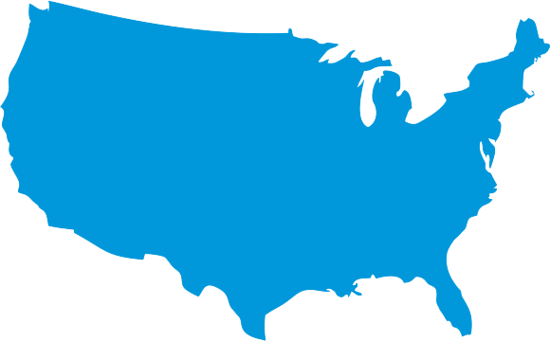
GROUP MEDICARE ADVANTAGE
Provider network access
96 percent of Minnesota providers
in network statewide
Broad provider access available in
all U.S. states and territories
Members may access any Medicare contracted provider that accepts Medicare assignment where network is not available

Slide 6

Group Medicare Advantage
FEATURES OF THIS PLAN
Broad provider network
Nationwide coverage in the U.S. and its territories
SilverSneakers®
Up to $150 eyewear allowance
$499 – $799 copay per hearing aid
E-visits with Doctor On Demand®
Acupuncture – non-Medicare covered services
Home delivered meal benefit following an approved inpatient stay
$50 per quarter over-the-counter benefit
6

Slide 7


OVER-THE-COUNTER MEDICATIONS AND SUPPLEMENTS ALLOWANCE
Receive a $50 quarterly allowance to purchase over-the-counter medications and supplements
ITEMS MAY BE ORDERED
  Online at cvs.com/otchs/bcbsmn
  Over the phone at 1-888-628-2770 Monday through Friday, 8 a.m. to 10 p.m., Central Time
ITEMS MAY BE PURCHASED IN STORE AT DESIGNATED CVS LOCATIONS
  Visit cvs.com/otchs/bcbsmn for more information

Slide 8
GROUP MEDICARE ADVANTAGE STANDARD (MA-ONLY) PPO
 | GROUP MEDICARE ADVANTAGE STANDARD
Deductible | $0
Annual out-of-pocket maximum | $3,000 in-network $3,000 combined
Office visit (Primary care) | $10 copay
Specialist visit | $20 copay
Preventive services* | $0
Inpatient hospital | $200 copay per stay
Emergency | $50 copay
Urgent care | $20 copay
Outpatient hospital surgery | $75 copay
Diabetic supplies (test strips and meters through Ascensia) | $0

Slide 9

SilverSneakers®
$0 enrollment cost at in-network facilities
Access to basic amenities at thousands of participating locations nationwide¹
Support from trained instructors²
Classes for all fitness levels²
Group fitness classes outside traditional gyms
SilverSneakers® On-Demand™ plus health and nutrition tips
SilverSneakers® GO™ mobile app with workout programs,
location finder and more
GetSetUp is an online environment where members may gather, learn, share, and socialize. Access through the member portal on the SilverSneakers website.
Z
  To find a local facility, visit silversneakers.com

Slide 10
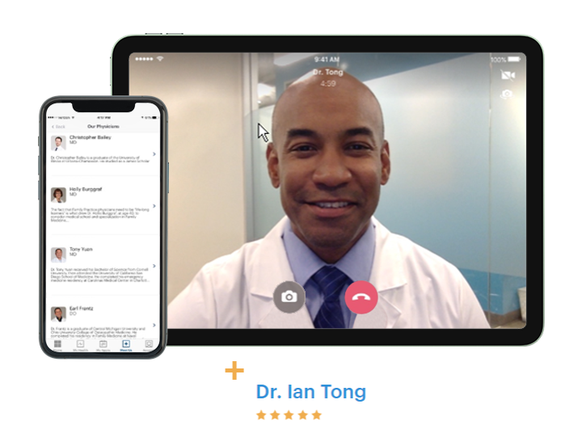

DOCTOR ON DEMAND®
Video chat with a doctor, psychologist or psychiatrist via your smartphone, tablet
or computer
Board-certified doctors are available
24 hours a day, 365 days a year
Specialist / Primary care copay applies based on care provided
Z
  doctorondemand.com/bluecrossmn

Slide 11

GROUP MEDICARE ADVANTAGE MEMBER RESOURCES
  ONLINE
  Visit bluecrossmn.com to:
  View claim history
  Find in-network doctors
  and hospitals
  Find quality ratings for doctors and other providers
  Send secure emails to
  customer service
  CUSTOMER SERVICE
  Call 1-800-711-9865 (TTY 711)
  Monday through Friday,
  8 a.m. to 8 p.m.*, Central Time

Slide 12

QUESTIONS ABOUT GROUP MEDICARE ADVANTAGE?

Slide 13
GROUP PLATINUM BLUESM
Eligibility requirements*
  RETIREE
  Have Medicare Part A and/or Part B
  Continue to pay Part B premium
  Be a permanent resident of Minnesota
  Reside in plan’s service area
  EMPLOYER GROUP / UNION
  Must be headquartered in Minnesota

Slide 14
GROUP PLATINUM BLUESM (COST)
Availability area
Aitkin
Carlton
Cook
Goodhue
Itasca
Kanabec
Koochiching
Lake
Le Sueur
McLeod
Meeker
Mille Lacs
Pine
Pipestone
Rice
Rock
Sibley
St. Louis
Stevens
Traverse
Yellow Medicine
Platinum Blue available in
these counties

Slide 15


GROUP PLATINUM BLUESM
FEATURES
Easy access to providers in Minnesota
Travel benefits U.S. and worldwide
Preventive care services included
Nurse line
SilverSneakers®
$150 annual eyewear benefit for non-Medicare covered eyewear
$499 – $799 copay per hearing aid
Acupuncture – non-Medicare covered
acupuncture services
Over-the-Counter Benefit provides $50 quarterly allowance through CVS

Slide 16

GROUP PLATINUM BLUESM
Plan C Medical coverage
BENEFITS | COST
Deductible | $0
Office visits | $20 copay
Preventive services | $0
Inpatient hospital care | $200 copay per stay
Emergency | $50 copay
Urgent care | $20 copay
Durable medical equipment (DME) | 20% coinsurance
Over-the-counter benefit | $50 per quarter
Annual out-of-pocket maximum | $3,000

Slide 17
GROUP PLATINUM BLUESM MEMBER RESOURCES
  ONLINE
  Visit bluecrossmn.com to:
  View claim history
  Find in-network doctors
  and hospitals
  Find quality ratings for doctors and other providers
  Send secure emails to
  customer service
  CUSTOMER SERVICE
  Call 1-866-340-8654 (TTY 711) Monday through Friday,
  8 a.m. to 8 p.m.*, Central Time

Slide 18

QUESTIONS ABOUT
GROUP PLATINUM BLUESM?

Slide 19
GROUP MEDICAREBLUESM RX (PDP)
Eligibility requirements
  RETIREE
  Be identified as an eligible plan participant by your employer
  Be entitled to Medicare benefits under Part A
  and /or enrolled in Medicare Part B
  Continue to pay your Part B premium
  Live in the plan’s service area
  You are a U.S. citizen or lawfully present
  in the U.S.
  Please note: May only be enrolled in one Part D plan at any time
  EMPLOYER GROUP / UNION
  Must be headquartered in Minnesota

Slide 20

GROUP MEDICAREBLUESM RX
Prescription drug coverage
FEATURES
Stand-alone Medicare Part D plan
Helps pay for generic and brand-name drugs
Includes some coverage for supplemental drugs
Offers a 90-day supply for two copays
More than 63,000 participating pharmacies nationwide
No deductible
[

Slide 21
GROUP MEDICAREBLUESM RX
$10 / $25 / $60 / 25%
 | 30-day Supply from a Network Pharmacy or 31-day Supply from a Long-Term Care Facility | 90-day Supply from a Network Pharmacy or Mail Order
Tier 1: Generic drugs | $10 copay | $20 copay
Tier 2: Preferred brand drugs | $25 copay | $50 copay
Tier 3: Non-Preferred brand drugs | $60 copay | $120 copay
Tier 4: Specialty drugs | 25% coinsurance | 25% coinsurance
Coverage gap After total yearly drug costs reach $4,660 | You pay no more than your usual cost sharing for generic and brand-name drugs
Catastrophic coverage Amount you pay after annual out-of-pocket prescription drug costs reach $7,400 | The greater of $4.15 copay for generic drugs and $10.35 copay for all other covered drugs, or 5% coinsurance.
Supplemental drugs* | 25% coinsurance | 25% coinsurance

Slide 22
GROUP MEDICAREBLUESM RX
 | 30-day Supply from a Network Pharmacy or 31-day Supply from a Long-Term Care Facility | 90-day Supply from a Network Pharmacy or Mail Order
Tier 1: Preferred Generic drugs | $5 copay | $10 copay
Tier 2: Generic brand drugs | $10 copay | $20 copay
Tier 3: Preferred brand drugs | 20% coinsurance | 20% coinsurance
Tier 4: Non-Preferred drugs | 45% coinsurance | 45% coinsurance
Tier 5: Specialty drugs | 33% coinsurance | 33% coinsurance
Coverage gap After total yearly drug costs reach $4,660 | You pay your usual copay for tier 1 drugs and copay for tier 2 drugs. You will generally pay no more than 25% of the plan's cost for all other tiers or tier 3, tier 4 and tier 5.
Catastrophic coverage Amount you pay after annual out-of-pocket prescription drug costs reach $7,400 | The greater of $4.15 copay for generic drugs and $10.35 copay for all other covered drugs, or 5% coinsurance.
Supplemental drugs* | Not covered | Not covered

Slide 23
IF YOUR DRUG IS NOT ON THE FORMULARY
  TALK TO YOUR DOCTOR
  He or she can review the formulary and prescribe a similar drug for your condition
  REQUEST A
  FORMULARY EXCEPTION
  If other drugs won’t be as effective, your doctor can ask the plan to cover the drug
  REQUEST A
  TRANSITION SUPPLY
  You can request up to a 30-day transition supply during your first 90 days of membership

Slide 24


GROUP MEDICAREBLUESM RX
Diabetic supply coverage
  PART B MEDICAL INSURANCE
  Strips
  Machines
  Calibration solutions
  Lancets
  PART D PRESCRIPTION DRUG BENEFIT
  Syringes
  Insulin
  Needles
  Alcohol swabs
[

Slide 25
VACCINATION COVERAGE WITH GROUP MEDICAREBLUESM RX
Using your Part D coverage for vaccinations
  AT THE PHARMACY
  You buy the Part D vaccine at the pharmacy and the pharmacist administers the vaccine.*
  You pay the pharmacy your copay and cost for
  administering the vaccine
  The plan pays the remainder
  of the costs
  AT THE DOCTOR’S OFFICE
  You get the Part D vaccination
  at your doctor’s office.
  You pay the entire cost upfront
  Submit a claim to your plan
  Plan reimburses you a portion of the amount you paid
  PHARMACY AND
  DOCTOR’S OFFICE
  You buy the Part D vaccine at your pharmacy and take it to your doctor’s office where the doctor administers the vaccine.
  You pay the pharmacy your copay for the vaccine solution
  You pay your doctor the entire cost of administering it
  Submit a claim to your plan
  Plan reimburses you a portion of the amount you paid

Slide 26
GROUP MEDICAREBLUESM RX MEMBER RESOURCES
  ONLINE
  Visit YourMedicareSolutions.com/
  GroupPlans
  to see:
  Forms
  Formulary
  Pharmacy locator
  CUSTOMER SERVICE
  Call 1-877-838-3827 (TTY 711)
  daily, 8 a.m. to 8 p.m.*, Central and Mountain Times

Slide 27

QUESTIONS ABOUT GROUP MEDICAREBLUESM RX?

Slide 28
2023 Group Medicare Renewal
Group Medicare Advantage Standard (MA only PPO) with Group MedicareBlue Rx (PDP)
High Option Rx | 2022 | 2023
Group Medicare Advantage Standard Plan | $133.00 | $127.00
Group MedicareBlue RX $10/$25/$60/25% | $238.50 | $213.50
Total monthly premium per member | $371.50 | $340.50
Low Option Rx | 2022 | 2023
Group Medicare Advantage Standard Plan | $133.00 | $127.00
Group MedicareBlue RX $5/$10/20%/45%/33% | $168.70 | $156.00
Total monthly premium per member | $301.70 | $283.00

Slide 29
2023 Group Medicare Renewal
Group Platinum Blue Plan C with Group MedicareBlue Rx
High Option Rx | 2022 | 2023
Group Platinum Blue Plan C | $100.50 | $110.50
Group MedicareBlue RX $10/$25/$60/25% | $238.50 | $213.50
Total monthly premium per member | $339.00 | $324.00
Low Option Rx | 2022 | 2023
Group Platinum Blue Plan C | $100.50 | $110.50
Group MedicareBlue RX $5/$10/20%/45%/33% | $168.70 | $156.00
Total monthly premium per member | $269.20 | $266.50

Slide 30






WHY BLUE CROSS?
With Blue Cross and Blue Shield of Minnesota, you get a name you trust, coverage you can count on,
and peace of mind knowing your plan is here to help you every step of the way.
90 years
of experience
Local customer service teams
Broad network access
Proud to be a nonprofit company
Almost half
of all Minnesota seniors have a Blue Cross plan¹
[
Notes:
90 years of experience
As one of the nation’s founding health plans, Blue Cross’ commitment to ensuring everyone has access to quality, affordable health care is unmatched
Broad network access
With 96% of Minnesota hospitals and doctors in network*, you’re covered just about anywhere you go
Almost half of all Minnesota seniors have a Blue Cross plan²
Blue Cross has been offering Medicare plans since Medicare first started in 1965 and know how to make the most of your Medicare dollar
Local customer service teams
You can rely on local customer service teams to provide expert guidance and support to get the most from your plan
Proud to be a nonprofit company
Focused on making you healthy, instead of making shareholders wealthy
*Internal Blue Cross and Blue Shield of Minnesota data, 2022

Slide 31
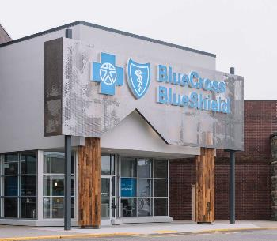
BLUE CROSS RETAIL CENTERS
EDINA
Phone: 612-844-0934 TTY 711
Address: 6807 York Avenue South, Edina, MN 55435
Hours: Monday through Friday, 8 a.m. to 5 p.m.
ROSEVILLE
Phone: 612-564-0909 TTY 711
Address: 1647B County Rd B2 West, Roseville, MN 55113
Hours: Monday through Friday, 8 a.m. to 5 p.m.
DULUTH
Phone: 218-522-9260 TTY 711
Address: 425 W Superior St #1060 Duluth, MN 55802
Hours: Currently closed for walk-in appointments. Please call for assistance.
ST. CLOUD
Phone: 320-227-8444 TTY 711
Address: 125 33rd Avenue South, St. Cloud, MN 56301
Hours: Monday through Friday, 8 a.m. to 5 p.m.
Visit bluecrossmn.com/centers to learn more and schedule an appointment.

Slide 32
OTHER USEFUL RESOURCES
BLUE CROSS AND BLUE SHIELD
OF MINNESOTA
  1-877-311-0404, TTY 711,
  8 a.m. to 8 p.m. Central Time, Daily
  bluecrossmn.com
  YourMedicareSolutions.com
  bluecrossmn.com/centers
SENIOR LINKAGE LINE®
  1-800-333-2433
  TTY 711
  seniorlinkageline.com
SOCIAL SECURITY
  1-800-772-1213
  TTY 1-800-325-0778
  7 a.m. to 7 p.m., Monday – Friday
  ssa.gov
MEDICARE HELPLINE
  7 days a week, 24 hours a day
  1-800-633-4227
  TTY 1-877-486-2048
  medicare.gov

Slide 33
2023
MEDICARE RENEWAL COMMUNICATIONS
TYPE | WHEN | RETIREE WILL RECEIVE
Medical Group Platinum Blue (Cost), Medicare Advantage (PPO) medical only | 15 days prior to either your open enrollment start date or your next plan year effective date | Annual Notice of Changes Important Plan Documents Flyer with applicable information on how to locate the Evidence of Coverage, provider directory, pharmacy directory, formulary
Prescription drug Group MedicareBlue Rx (PDP) | 15 days prior to either your open enrollment start date or your next plan year effective date | Annual Notice of Changes Schedule of Coverage and Limitations 2023 Group MedicareBlue Rx Formulary 2023 Group MedicareBlue Rx Supplemental drug List Insert on how to obtain a Pharmacy Directory, Formulary and Evidence of Coverage Low-income subsidy (LIS) for qualifying members who receive extra help to pay for costs

Slide 34
Questions?

Slide 35
IMPORTANT INFORMATION
Blue Cross offers PPO, Cost and PDP plans with Medicare contracts. Enrollment in these Blue Cross plans depends
on contract renewal. This information is not a complete description of benefits. Call 1-877-662-2583 / TTY 711 for more information.
Each healthcare provider is an independent contractor and not our agent. It is up to the member to confirm provider participation in their network prior to receiving services.
Out-of-network/non-contracted providers are under no obligation to treat Blue Cross and Blue Shield of Minnesota Medicare plan members, except in emergency situations. Please call our customer service number or see your Evidence of Coverage for more information, including the cost sharing that applies to out-of-network services.
Blue Cross® and Blue Shield® of Minnesota and Blue Plus® are nonprofit independent licensees of the Blue Cross
and Blue Shield Association. Blue Cross, Blue Shield, and the cross and shield symbols are registered marks of the
Blue Cross and Blue Shield Association. Platinum Blue and Group MedicareBlue Rx are service marks of the Blue Cross and Blue Shield Association. Senior Gold is a service mark of Blue Cross and Blue Shield of Minnesota. Aware is a registered mark of Blue Cross and Blue Shield of Minnesota.
Prime Therapeutics LLC, is an independent company providing pharmacy benefit management services.
Group MedicareBlueSM Rx (PDP) is a Medicare-approved Part D sponsor. Enrollment in Group MedicareBlue Rx depends on renewal of the plan sponsor’s contract with Medicare. Coverage is available to members of an employer or union group and separately issued by one of the following plans: Wellmark Blue Cross and Blue Shield of Iowa*; Blue Cross and Blue Shield of Minnesota*; Blue Cross and Blue Shield of Montana*, a division of Health Care Service Corporation, a Mutual Legal Reserve Company; Blue Cross and Blue Shield of Nebraska*; Blue Cross Blue Shield of North Dakota*; Wellmark Blue Cross and Blue Shield of South Dakota*; and Blue Cross Blue Shield of Wyoming*.
* Independent licensees of the Blue Cross and Blue Shield Association

Slide 36

THANK YOU.

